Slide 1
SIMILARITY AND DISTANCE

Slide 2
Similarity and Distance
For many different problems we need to quantify how close two objects are.
Examples:
For an item bought by a customer, find other similar items
Group together the customers of a site so that similar customers are shown the same ad.
Group together web documents so that you can separate the ones that talk about politics and the ones that talk about sports.
Find all the near-duplicate mirrored web documents.
Find credit card transactions that are very different from previous transactions.
To solve these problems we need a definition of similarity, or distance.
The definition depends on the type of data that we have

Slide 3
Similarity
Numerical measure of how alike two data objects are.
A function that maps pairs of objects to real values
Higher when objects are more alike.
Often falls in the range [0,1], sometimes in [-1,1]
Desirable properties for similarity
s(p, q) = 1 (or maximum similarity) only if p = q. (Identity)
s(p, q) = s(q, p) for all p and q. (Symmetry)

Slide 4
Similarity between sets
Consider the following documents
Which ones are more similar?
How would you quantify their similarity?
apple releases new ipod
apple releases new ipad
new apple pie recipe

Slide 5
Similarity: Intersection
Number of words in common
Sim(D,D) = 3, Sim(D,D) = Sim(D,D) =2
What about this document?
Sim(D,D) = Sim(D,D) = 3
apple releases new ipod
apple releases new ipad
new apple pie recipe
Vefa rereases new book with apple pie recipes

Slide 6
Jaccard Similarity
The Jaccard similarity (Jaccard coefficient) of two sets S₁, S₂ is the size of their intersection divided by the size of their union.
JSim (C₁, C₂) = |C₁∩C₂| / |C₁∪C₂|.
Extreme behavior:
Jsim(X,Y) = 1, iff X = Y
Jsim(X,Y) = 0 iff X,Y have no elements in common
JSim is symmetric
3 in intersection.
8 in union.
Jaccard similarity
= 3/8

Slide 7
Jaccard Similarity between sets
The distance for the documents
JSim(D,D) = 3/5
JSim(D,D) = JSim(D,D) = 2/6
JSim(D,D) = JSim(D,D) = 3/9
apple releases new ipod
apple releases new ipad
new apple pie recipe
Vefa rereases new book with apple pie recipes

Slide 8
Similarity between vectors
Documents (and sets in general) can also be represented as vectors
document | Apple | Microsoft | Obama | Election
D1 | 10 | 20 | 0 | 0
D2 | 30 | 60 | 0 | 0
D3 | 60 | 30 | 0 | 0
D4 | 0 | 0 | 10 | 20
How do we measure the similarity of two vectors?
We could view them as sets of words. Jaccard Similarity will show that D4 is different form the rest
But all pairs of the other three documents are equally similar
We want to capture how well the two vectors are aligned

Slide 9
Example
document | Apple | Microsoft | Obama | Election
D1 | 10 | 20 | 0 | 0
D2 | 30 | 60 | 0 | 0
D3 | 60 | 30 | 0 | 0
D4 | 0 | 0 | 10 | 20
apple
Documents D1, D2 are in the “same direction”
Document D3 is on the same plane as D1, D2
Document D3 is orthogonal to the rest
microsoft
{Obama, election}

Slide 10
Example
document | Apple | Microsoft | Obama | Election
D1 | 1/3 | 2/3 | 0 | 0
D2 | 1/3 | 2/3 | 0 | 0
D3 | 2/3 | 1/3 | 0 | 0
D4 | 0 | 0 | 1/3 | 2/3
apple
Documents D1, D2 are in the “same direction”
Document D3 is on the same plane as D1, D2
Document D3 is orthogonal to the rest
microsoft
{Obama, election}

Slide 11
Cosine Similarity
Sim(X,Y) = cos(X,Y)
The cosine of the angle between X and Y
If the vectors are aligned (correlated) angle is zero degrees and cos(X,Y)=1
If the vectors are orthogonal (no common coordinates) angle is 90 degrees and cos(X,Y) = 0
Cosine is commonly used for comparing documents, where we assume that the vectors are normalized by the document length.

Slide 12
Cosine Similarity - math
If d₁ and d₂ are two vectors, then
cos( d₁, d₂ ) = (d₁ • d₂) / ||d₁|| ||d₂|| ,
where • indicates vector dot product and || d || is the length of vector d.
Example:
d₁ = 3 2 0 5 0 0 0 2 0 0
d₂ = 1 0 0 0 0 0 0 1 0 2
d₁ • d₂= 3*1 + 2*0 + 0*0 + 5*0 + 0*0 + 0*0 + 0*0 + 2*1 + 0*0 + 0*2 = 5
||d₁|| = (3*3+2*2+0*0+5*5+0*0+0*0+0*0+2*2+0*0+0*0)^{0.5} = (42) ^{0.5} = 6.481
||d₂|| = (1*1+0*0+0*0+0*0+0*0+0*0+0*0+1*1+0*0+2*2) ^{0.5} = (6) ^{0.5} = 2.245
cos( d₁, d₂ ) = .3150

Slide 13
Example
document | Apple | Microsoft | Obama | Election
D1 | 10 | 20 | 0 | 0
D2 | 30 | 60 | 0 | 0
D3 | 60 | 30 | 0 | 0
D4 | 0 | 0 | 10 | 20
apple
Cos(D1,D2) = 1
Cos (D3,D1) = Cos(D3,D2) = 4/5
Cos(D4,D1) = Cos(D4,D2) = Cos(D4,D3) = 0
microsoft
{Obama, election}

Slide 14
Distance
Numerical measure of how different two data objects are
A function that maps pairs of objects to real values
Lower when objects are more alike
Higher when two objects are different
Minimum distance is 0, when comparing an object with itself.
Upper limit varies

Slide 15
Distance Metric
A distance function d is a distance metric if it is a function from pairs of objects to real numbers such that:
d(x,y) > 0. (non-negativity)
d(x,y) = 0 iff x = y. (identity)
d(x,y) = d(y,x). (symmetry)
d(x,y) < d(x,z) + d(z,y) (triangle inequality ).

Slide 16
Triangle Inequality
Triangle inequality guarantees that the distance function is well-behaved.
The direct connection is the shortest distance
It is useful also for proving useful properties about the data.

Slide 17
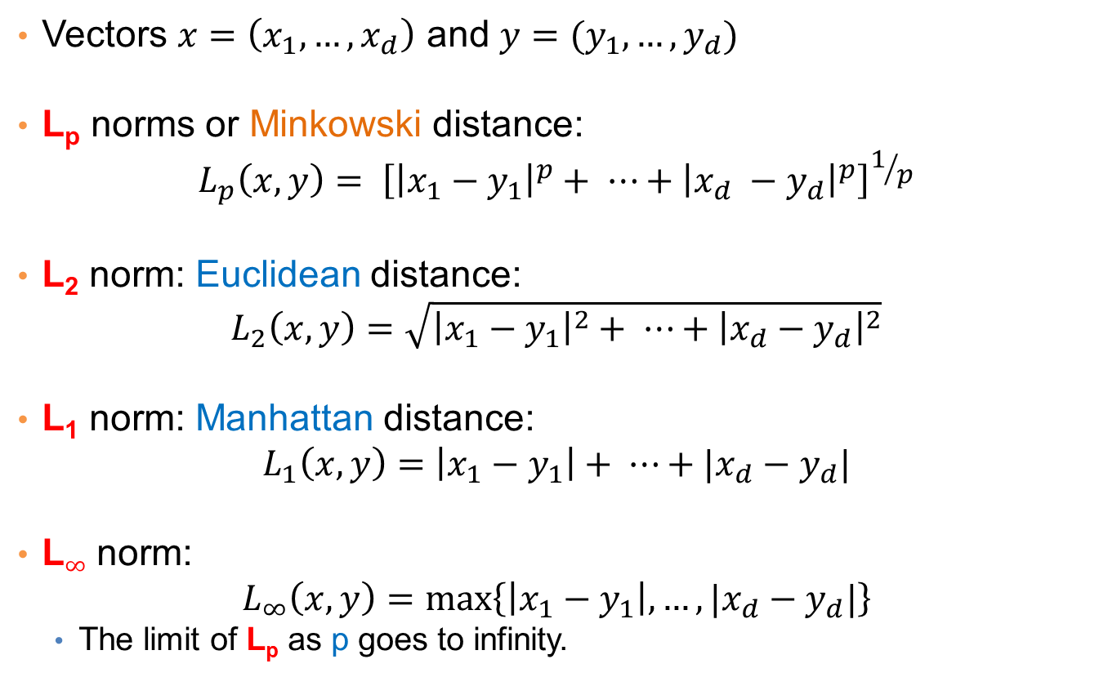
Distances for real vectors
Vectors $x=\left(x_{1},…,x_{d}\right)$ and $y=(y_{1},…,y_{d})$
L_{p} norms or Minkowski distance:
$$L_{p}\left(x,y\right)= {\left[{\left|x_{1}−y_{1}\right|}^{p}+ ⋯+{\left|x_{d} −y_{d}\right|}^{p}\right]}^{1/p}$$
L₂ norm: Euclidean distance:
$$L_{2}\left(x,y\right)=\sqrt{{\left|x_{1}−y_{1}\right|}^{2}+ ⋯+{\left|x_{d}−y_{d}\right|}^{2}}$$
L₁ norm: Manhattan distance:
$$L_{1}\left(x,y\right)=\left|x_{1}−y_{1}\right|+ ⋯+|x_{d}−y_{d}|$$
L$∞$ norm:
$$L_{∞}\left(x,y\right)=\max\left\{\left|x_{1}−y_{1}\right|,…,|x_{d}−y_{d}|\right\}$$
The limit of L_{p} as p goes to infinity.
L_{p} norms are known to be distance metrics

Slide 18
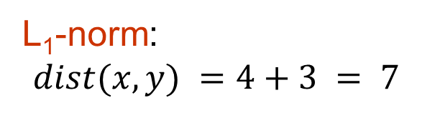
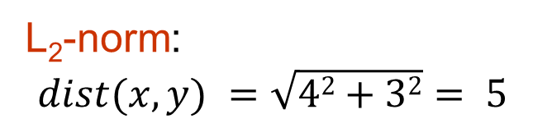
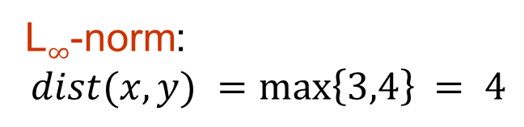
Example of Distances
y = (9,8)
L₂-norm:
$$dist(x,y) =\sqrt{42+32}= 5$$
5
3
L₁-norm:
$$dist(x,y) =4+3 = 7$$
4
x = (5,5)
L$∞$-norm:
$$dist(x,y) =\max\left\{3,4\right\}⁡= 4$$

Slide 19

Example
r
$$x= (x_{1},…,x_{n})$$
Green: All points y at distance L₁(x,y) = r from point x
Blue: All points y at distance L₂(x,y) = r from point x
Red: All points y at distance L$∞$(x,y) = r from point x

Slide 20
L_{p} distances for sets
We can apply all the L_{p} distances to the cases of sets of attributes, with or without counts, if we represent the sets as vectors
E.g., a transaction is a 0/1 vector
E.g., a document is a vector of counts.

Slide 21
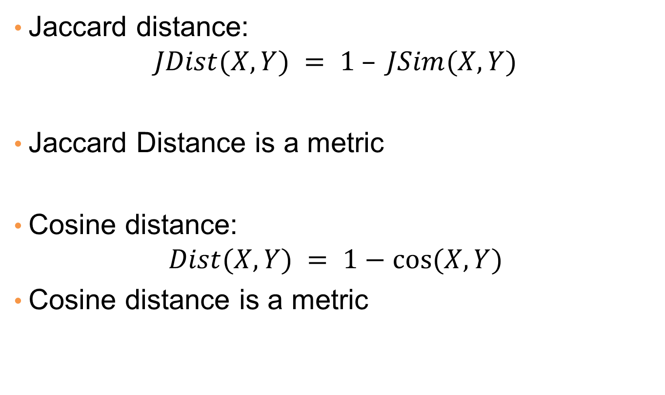
Similarities into distances
Jaccard distance:
$$JDist(X,Y) = 1 – JSim(X,Y)$$
Jaccard Distance is a metric
Cosine distance:
$$Dist(X,Y) = 1−cos⁡(X,Y)$$
Cosine distance is a metric

Slide 22
Why Jaccard Distance Is a Distance Metric
JDist(x,x) = 0
since JSim(x,x) = 1
JDist(x,y) = JDist(y,x)
by symmetry of intersection
JDist(x,y) > 0
since intersection of X,Y cannot be bigger than the union.
Triangle inequality:
Follows from the fact that JSim(X,Y) is the probability of randomly selected element from the union of X and Y to belong to the intersection

Slide 23
Hamming Distance
Hamming distance is the number of positions in which bit-vectors differ.
Example: p₁ = 10101 p₂ = 10011.
d(p₁, p₂) = 2 because the bit-vectors differ in the 3rd and 4th positions.
The L₁ norm for the binary vectors
Hamming distance between two vectors of categorical attributes is the number of positions in which they differ.
Example: x = (married, low income, cheat), y = (single, low income, not cheat)
d(x,y) = 2

Slide 24
Why Hamming Distance Is a Distance Metric
d(x,x) = 0 since no positions differ.
d(x,y) = d(y,x) by symmetry of “different from.”
d(x,y) > 0 since strings cannot differ in a negative number of positions.
Triangle inequality: changing x to z and then to y is one way to change x to y.
For binary vectors if follows from the fact that L₁ norm is a metric

Slide 25
Distance between strings
How do we define similarity between strings?
Important for recognizing and correcting typing errors and analyzing DNA sequences.
weird wierd
intelligent unintelligent
Athena Athina

Slide 26
Edit Distance for strings
The edit distance of two strings is the number of inserts and deletes of characters needed to turn one into the other.
Example: x = abcde ; y = bcduve.
Turn x into y by deleting a, then inserting u and v after d.
Edit distance = 3.
Minimum number of operations can be computed using dynamic programming
Common distance measure for comparing DNA sequences

Slide 27
Why Edit Distance Is a Distance Metric
d(x,x) = 0 because 0 edits suffice.
d(x,y) = d(y,x) because insert/delete are inverses of each other.
d(x,y) > 0: no notion of negative edits.
Triangle inequality: changing x to z and then to y is one way to change x to y. The minimum is no more than that

Slide 28
Variant Edit Distances
Allow insert, delete, and mutate.
Change one character into another.
Minimum number of inserts, deletes, and mutates also forms a distance measure.
Same for any set of operations on strings.
Example: substring reversal or block transposition OK for DNA sequences
Example: character transposition is used for spelling

Slide 29
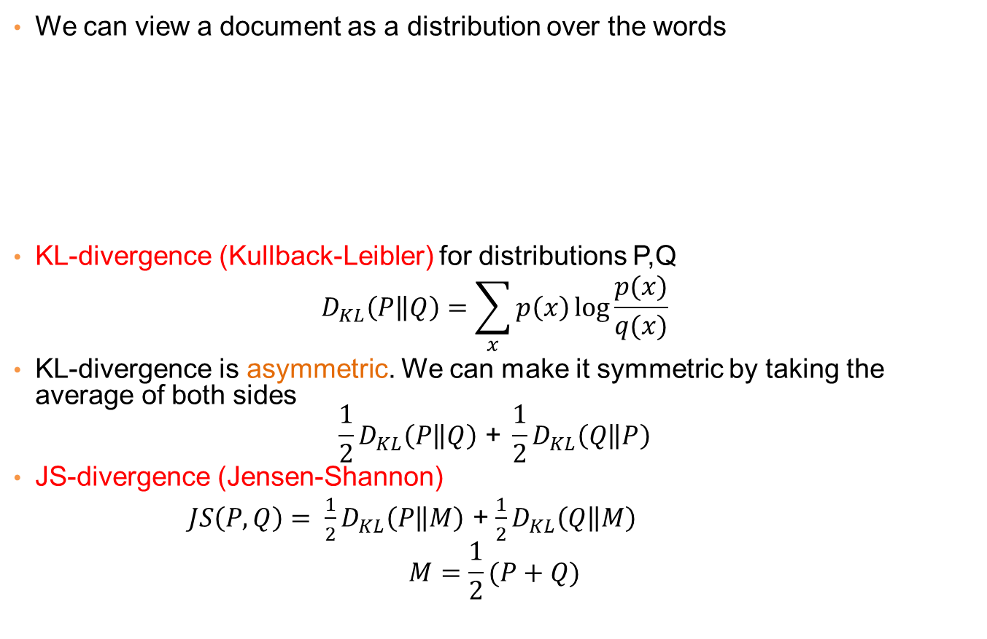
Distances between distributions
We can view a document as a distribution over the words
KL-divergence (Kullback-Leibler) for distributions P,Q
$$D_{KL}\left(P\left\|Q\right.\right)=\sum_{x}{p\left(x\right)\log{\frac{p(x)}{q(x)}}}$$
KL-divergence is asymmetric. We can make it symmetric by taking the average of both sides
$$\frac{1}{2}D_{KL}\left(P\left\|Q\right.\right)\text{ + }\frac{1}{2}D_{KL}\left(Q\left\|P\right.\right)$$
JS-divergence (Jensen-Shannon)
$JS\left(P,Q\right)= \frac{1}{2}D_{KL}\left(P\left\|M\right.\right)$ + $\frac{1}{2}D_{KL}\left(Q\left\|M\right.\right)$
$$M=\frac{1}{2}(P+Q)$$
document | Apple | Microsoft | Obama | Election
D1 | 0.35 | 0.5 | 0.1 | 0.05
D2 | 0.4 | 0.4 | 0.1 | 0.1
D2 | 0.05 | 0.05 | 0.6 | 0.3
M: Average distribution

Slide 30
Why is similarity important?
We saw many definitions of similarity and distance
How do we make use of similarity in practice?
What issues do we have to deal with?

Slide 31
Applications of Similarity: Recommendation Systems

Slide 32
An important problem
Recommendation systems
When a user buys an item (initially books) we want to recommend other items that the user may like
When a user rates a movie, we want to recommend movies that the user may like
When a user likes a song, we want to recommend other songs that they may like
A big success of data mining
Exploits the long tail
How Into Thin Air made Touching the Void popular

Slide 33
Utility (Preference) Matrix
 | Harry Potter 1 | Harry Potter 2 | Harry Potter 3 | Twilight | Star Wars 1 | Star Wars 2 | Star Wars 3
A | 4 |  |  | 5 | 1
B | 5 | 5 | 4
C |  |  |  | 2 | 4 | 5
D |  | 3 |  |  |  |  | 3
How can we fill the empty entries of the matrix?

Slide 34
Recommendation Systems
Content-based:
Represent the items into a feature space and recommend items to customer C similar to previous items rated highly by C
Movie recommendations: recommend movies with same actor(s), director, genre, …
Websites, blogs, news: recommend other sites with “similar” content

Slide 35
Content-based prediction
 | Harry Potter 1 | Harry Potter 2 | Harry Potter 3 | Twilight | Star Wars 1 | Star Wars 2 | Star Wars 3
A | 4 |  |  | 5 | 1
B | 5 | 5 | 4
C |  |  |  | 2 | 4 | 5
D |  | 3 |  |  |  |  | 3
Someone who likes one of the Harry Potter (or Star Wars)
movies is likely to like the rest
Same actors, similar story, same genre

Slide 36
Intuition
Item profiles
likes
build
recommend
match
Red
Circles
Triangles
User profile

Slide 37
Approach
Map items into a feature space:
For mocvies:
Actors, directors, genre, rating, year,…
Challenge: make all features compatible.
For documents?
To compare items with users we need to map users to the same feature space. How?
Take all the movies that the user has seen and take the average vector
Other aggregation functions are also possible.
Recommend to user C the most similar item I computing similarity in the common feature space
Distributional distance measures also work well.

Slide 38
Limitations of content-based approach
Finding the appropriate features
e.g., images, movies, music
Overspecialization
Never recommends items outside user’s content profile
People might have multiple interests
Recommendations for new users
How to build a profile?

Slide 39
Collaborative filtering
 | Harry Potter 1 | Harry Potter 2 | Harry Potter 3 | Twilight | Star Wars 1 | Star Wars 2 | Star Wars 3
A | 4 |  |  | 5 | 1
B | 5 | 5 | 4
C |  |  |  | 2 | 4 | 5
D |  | 3 |  |  |  |  | 3
Two users are similar if they rate the same items in a similar way
Recommend to user C, the items
liked by many of the most similar users.

Slide 40
User Similarity
 | Harry Potter 1 | Harry Potter 2 | Harry Potter 3 | Twilight | Star Wars 1 | Star Wars 2 | Star Wars 3
A | 4 |  |  | 5 | 1
B | 5 | 5 | 4
C |  |  |  | 2 | 4 | 5
D |  | 3 |  |  |  |  | 3
Which pair of users do you consider as the most similar?
What is the right definition of similarity?

Slide 41
User Similarity
 | Harry Potter 1 | Harry Potter 2 | Harry Potter 3 | Twilight | Star Wars 1 | Star Wars 2 | Star Wars 3
A | 1 |  |  | 1 | 1
B | 1 | 1 | 1
C |  |  |  | 1 | 1 | 1
D |  | 1 |  |  |  |  | 1
Jaccard Similarity: users are sets of movies
Disregards the ratings.
Jsim(A,B) = 1/5
Jsim(A,C) = Jsim(B,D) = 1/2

Slide 42
User Similarity
 | Harry Potter 1 | Harry Potter 2 | Harry Potter 3 | Twilight | Star Wars 1 | Star Wars 2 | Star Wars 3
A | 4 |  |  | 5 | 1
B | 5 | 5 | 4
C |  |  |  | 2 | 4 | 5
D |  | 3 |  |  |  |  | 3
Cosine Similarity:
Assumes zero entries are negatives:
Cos(A,B) = 0.38
Cos(A,C) = 0.32

Slide 43
User Similarity
 | Harry Potter 1 | Harry Potter 2 | Harry Potter 3 | Twilight | Star Wars 1 | Star Wars 2 | Star Wars 3
A | 2/3 |  |  | 5/3 | -7/3
B | 1/3 | 1/3 | -2/3
C |  |  |  | -5/3 | 1/3 | 4/3
D |  | 0 |  |  |  |  | 0
Normalized Cosine Similarity:
Subtract the mean and then compute Cosine
(correlation coefficient)
Corr(A,B) = 0.092
Cos(A,C) = -0.559

Slide 44
User-User Collaborative Filtering
Consider user c
Find set D of other users whose ratings are most “similar” to c’s ratings
Estimate user’s ratings based on ratings of users in D using some aggregation function
Advantage: for each user we have small amount of computation.

Slide 45
Item-Item Collaborative Filtering
We can transpose (flip) the matrix and perform the same computation as before to define similarity between items
Intuition: Two items are similar if they are rated in the same way by many users.
Better defined similarity since it captures the notion of genre of an item
Users may have multiple interests.
Algorithm: For each user c and item i
Find the set D of most similar items to item i that have been rated by user c.
Aggregate their ratings to predict the rating for item i.
Disadvantage: we need to consider each user-item pair separately

Slide 46
Pros and cons of collaborative filtering
Works for any kind of item
No feature selection needed
New user problem
New item problem
Sparsity of rating matrix
Cluster-based smoothing?

Slide 47
SKETCHING AND LOCALITY SENSITIVE HASHING
Thanks to:
Rajaraman and Ullman, “Mining Massive Datasets”
Evimaria Terzi, slides for Data Mining Course.

Slide 48
Another important problem
Find duplicate and near-duplicate documents from a web crawl.
Why is it important:
Identify mirrored web pages, and avoid indexing them, or serving them multiple times
Find replicated news stories and cluster them under a single story.
Identify plagiarism
What if we wanted exact duplicates?

Slide 49
Finding similar items
Both the problems we described have a common component
We need a quick way to find highly similar items to a query item
OR, we need a method for finding all pairs of items that are highly similar.
Also known as the Nearest Neighbor problem, or the All Nearest Neighbors problem
We will examine it for the case of near-duplicate web documents.

Slide 50
Main issues
What is the right representation of the document when we check for similarity?
E.g., representing a document as a set of characters will not do (why?)
When we have billions of documents, keeping the full text in memory is not an option.
We need to find a shorter representation
How do we do pairwise comparisons of billions of documents?
If we wanted exact match it would be ok, can we replicate this idea?

Slide 51
Three Essential Techniques for Similar Documents
Shingling : convert documents, emails, etc., to sets.
Minhashing : convert large sets to short signatures, while preserving similarity.
Locality-Sensitive Hashing (LSH): focus on pairs of signatures likely to be similar.

Slide 52
The Big Picture
Candidate
pairs :
those pairs
of signatures
that we need
to test for
similarity.
Shingling
Minhash-
ing
Locality-
sensitive
Hashing
Docu-
ment
The set
of strings
of length k
that appear
in the doc-
ument
Signatures :
short integer
vectors that
represent the
sets, and
reflect their
similarity

Slide 53
Shingles
A k -shingle (or k -gram) for a document is a sequence of k characters that appears in the document.
Example: document = abcab. k=2
Set of 2-shingles = {ab, bc, ca}.
Option: regard shingles as a bag, and count ab twice.
Represent a document by its set of k-shingles.

Slide 54
Shingling
Shingle: a sequence of k contiguous characters
a rose is a rose is a rose
a rose is
rose is a
rose is a
ose is a r
se is a ro
e is a ros
is a rose
is a rose
s a rose i
a rose is
a rose is

Slide 55
Working Assumption
Documents that have lots of shingles in common have similar text, even if the text appears in different order.
Careful: you must pick k large enough, or most documents will have most shingles.
Extreme case k = 1: all documents are the same
k = 5 is OK for short documents; k = 10 is better for long documents.
Alternative ways to define shingles:
Use words instead of characters
Anchor on stop words (to avoid templates)

Slide 56
Shingles: Compression Option
To compress long shingles, we can hash them to (say) 4 bytes.
Represent a doc by the set of hash values of its k-shingles.
From now on we will assume that shingles are integers
Collisions are possible, but very rare

Slide 57
Fingerprinting
Hash shingles to 64-bit integers
Set of Shingles
Set of 64-bit integers
Hash function
(Rabin’s fingerprints)
a rose is
rose is a
rose is a
ose is a r
se is a ro
e is a ros
is a rose
is a rose
s a rose i
a rose is
1111
2222
3333
4444
5555
6666
7777
8888
9999
0000

